Slide 1
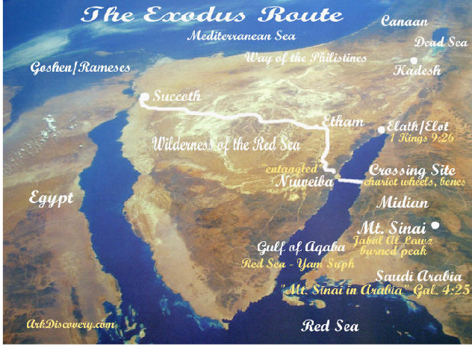
How Moses Crossed the Gulf of Aqaba With a slip-dip transform plate boundary, clasts from a huge drainage tree washing onto an underwater land bridge, a pillar of fire to light the way, and a lot of help from God who left fried, igneous rocks on Mt Sinai after He wrote the Ten Commandments.
It was NEVER the Red Sea. It was always the Gulf of Aqaba. Mt. Sinai is not and has never been on the Sinai peninsula. Galatians 4:25 says it is in Arabia.
There are other proposals for the crossing of the Red Sea. The proposal discussed here completes the puzzle and drops the last pieces into place in reconciling the biblical account the best.
Notes:
This important because it is the most significant event of the Old Testament underlying two monotheistic faiths.
Putative crossing sites have not been completely explored geologically due to severe restrictions of Saudi Arabia where the Ten Commandments were given.
Because of its intimate connection to religious beliefs, many scientists do not want to undertake further studies and are restricted by the Saudis from doing so.
Also, the accompanying miracles are so profound as to discourage inquiry by the skeptical.
I contributed most to the geological observations, except the washing of the clasts onto the land bridge which was proposed by investigators.
The project gave a great chance to apply what I learned in the course to the real world geological structures and at the same time glorify God.
References are in the notes section of Slide 18. They are online references.
All pictures and maps are from The Exodus Discovery which had the best, largest, and clearest pictures and maps of multiple sources.

Slide 2
What Archaeological Naysayers and Experts Said
Historians, archaeologists and Egyptologists have the consensus that the there is no evidence that Exodus event happened as described in the Bible.
“No archaeological, scholarly verified evidence has been found that confirms the crossing of the Red Sea ever took place” – Wikipedia.
“There has never been any proof that the Israelites were enslaved in Ancient Egypt – and it is questioned if the figure of Moses ever existed.” (They never heard of the Papyrus Ipuwer in the Dutch National Museum of Antiquities in Leiden, Netherlands).
Some suggestions have been offered – such as a freak tidal event or tsunami, Tsunami waters return very swiftly and the sea could not stay open for 24 hours which was required to get
2 million people across.
Also, the Red Sea is a mistranslation of Reed Sea which refers to a lake where the Israelites could shelter but Pharaoh’s chariots ended up bogging down, so Israel escaped.
When books and articles like the Exodus Case, (principal source for this presentation), are published , archaeology groups claim, “junk science”, and its investigators, ‘hoaxers’ with no formal archaeology training”.. Naysayers and deniers will always mock. God loves amateurs and all things are possible with HIM.
But also there is evidence that a mass migration took place at this spot with unique geological finding that contributed to this exodus.
Notes:
The Players
Ron Wyatt who discovered the true Mt. Sinai and the crossing at Nuweiba with Solomon's Columns commemorating it on each shore.
Penny Caldwell who discovered the Rock of Horeb.
Flavius Josephus 100 A.D., Jewish historian, who expanded biblical details of the Exodus crossing, (Antiquities of the Jews).
Lennart Möller who put it all together in his wonderful book, The Exodus Case also an online book http://library.mibckerala.org/lms_frame/eBook/The%20Exodus%20Case%20- %20Dr.%20Lennart%20Moller.pdf
Ron Wyatt and Lennart Möller did not have geology training at the time of their expeditions and no geologist accompanied them
Judy Gassett who read Marshak, (author of geology textbook), and added crumbs of geology in support of the Exodus Case.
All references are online in the notes of slide 18

Slide 3
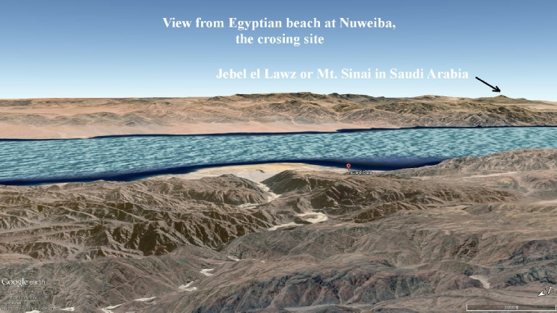
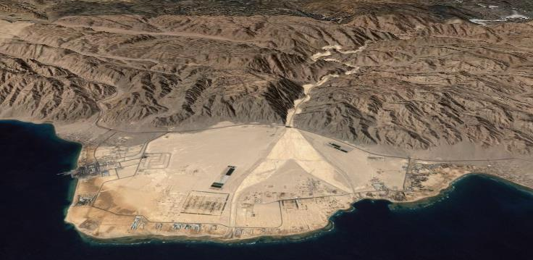
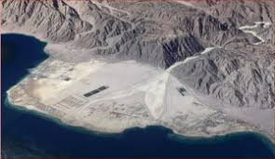
How Geology Facilitated the Crossing of the Gulf of Aqaba
Destination
Wadi Watir opens onto the large Nuweiba (new way bah) Peninsula. Note the very rugged, inhospitable mountains drained by dendridtic streams

Slide 4
Who Was Moses? Moses, a principal prince of Egypt, advanced to co-ruler after defeating the Ethiopians and was named Thutmosis II (notice the similarity with "Moses”).
There were always two pharaohs, one to rule the in the Upper Nile and one to rule the Lower Nile. Moreover, “Thutmosis” and “Amenhotep” were honorary titles more than names. Pharaoh succeeding Moses after he was driven out, was Thutmosis III. Pharaoh at the time of the Exodus was Amenhotep III. Next ruler would have been Tutankhamen.
There is an ancient papyrus called “Admonitions of Ipuwer”* (in the Dutch Museum of Antiquities, Leiden) which confirms the biblical account and describes a society in total crisis reading “like a report from a war correspondent”. It states: “Egypt is suffering total disaster while the slaves have become rich with the wealth of their former owners”.
The hieroglyphs on Tutankhamen’s tomb say that the burial chamber is not his. In fact, the tomb was intended for and built by Tut’s father who drowned. Considering the necessity to bury a huge number of dead first-born, Tut was buried in his father’s prepared tomb out of critical necessity. When his tomb was found in 1922 the splendor of the chamber was such that Howard Carter named him a “king”. The chariot wheels inside matched the ones found in the Gulf of Aqaba: those of the 18th Dynasty.
Surviving widowed queen of Egypt sent a letter with her ambassador to Hittite king Suppiluliumas with these terms: “My husband is dead as is my son. People say that you have many sons. If you send me one of your sons he will become my husband for it is repugnant to me to take one of my servants to husband.” A new pharaoh, Akhenaten took the throne shortly after the destruction in Egypt. He moved the capital and introduced a monotheistic worship which lasted at least until the end of his reign.
Bottom line: This presentation will show geology helped to overturn an entire society disrupting its military superiority among nations 3,900 years ago in Egypt!
Notes:
References are the narration of The Exodus Case by Lennart Möller, M.D., who put it all together in his wonderful book, Exodus Case The Exodus Case 3rd ed also an online book (see the link)
*Dr. Moller visited the Dutch Museum of antiquities and inspected the papyrus which has the translation.
The story is broken, incomplete and boring without Moses. He is essential to my narrative. Background completes some missing pieces in the historical account.

Slide 5
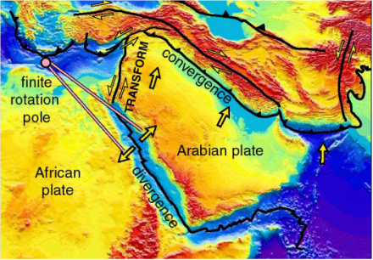
Geology of the Gulf of Aqaba 1
Gulf of Aqaba is a transform boundary comparable to the Gulf of California-Imperial Valley. These are the only two places in the world where a mid-oceanic ridge system changes into a transform system and runs into the continent.⁵ Transform plate boundaries are the only boundaries which do not produce volcanic mountains.
So where did these tall, jagged mountains come from?
The surrounding mountains are granite. During the Precambrian, thinning crust is thought to have rifted allowing plutonic intrusions of granite to rise resulting in the Arabian-African shield.⁸
Later, two types of slipping of the granite intrusions are thought to have started in the late Miocene.² At a transform plate boundary horizontal faulting occurs. Plates slip past one another laterally. For Aqaba, the horizontal movement was left-lateral dip-slip displacement². Additionally, normal faulting led to great vertical fractures as the crust gave rise to fault-block mountains. These may rotate down along normal faults producing basins with associated mountain ranges. Uplifting forces from normal faulting continued right into the Gulf of Aqaba.
Gulf of Aqaba, a transform plate boundary
The Red Sea, a divergent plat boundary
Notes:
2. Evaluation of the Crustal Features of the Gulf of Aqaba Deduced from Geophysical Data (scirp.org)
5. Transform plate boundary of Aqaba diagram credit : Extentional parting of the Red Sea
8. Granite from the Gulf of Aqaba

Slide 6
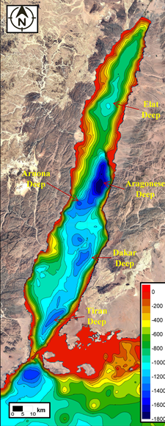
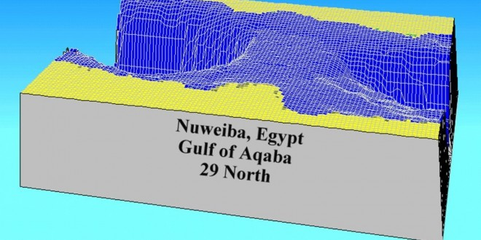
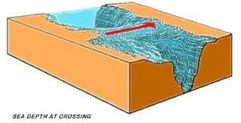
Geology of Land Bridge
Aqaba gulf contains three small pull-apart basins, the Elat Deep, Aragonese Deep and Dakar Deep, formed between four left lateral strike-slip fault segments. One is on the North at 900m and one on the South at 1,800m. The first two border a much shallower intrabasin sill area². The sedimentation rate is very low in the Gulf of Aqaba, approximately 5 cm/1,000 years^{3.}
An underwater bridge likely raised as a block fault extended from Nuwieba Peninsula to the Saudi Arabia. It was flat and broad, at least 2 km wide, and was covered with clasts from the wash coming from the steep close-by ravines canyons at both coasts
Using points on Nuwieba and Arabia peninsulas “showed a calculated gradient below what is accepted for disabled people”⁴. (12%). That is only 2 points 8 miles apart. We would like more reference points, but the Saudis won’t permit it. Today, given the seismicity of the region and the slip/strike character of its ongoing geology, any land bridge may have been partially displaced along its length during one of the gulf’s many seismic episodes.
Nuwieba
Crossing exit
Notes:
2 Evaluation of the Crustal Features of the Gulf of Aqaba Deduced from Geophysical Data (scirp.org)
3 Seismic Hazard Implication
4 The Exodus Case

Slide 7
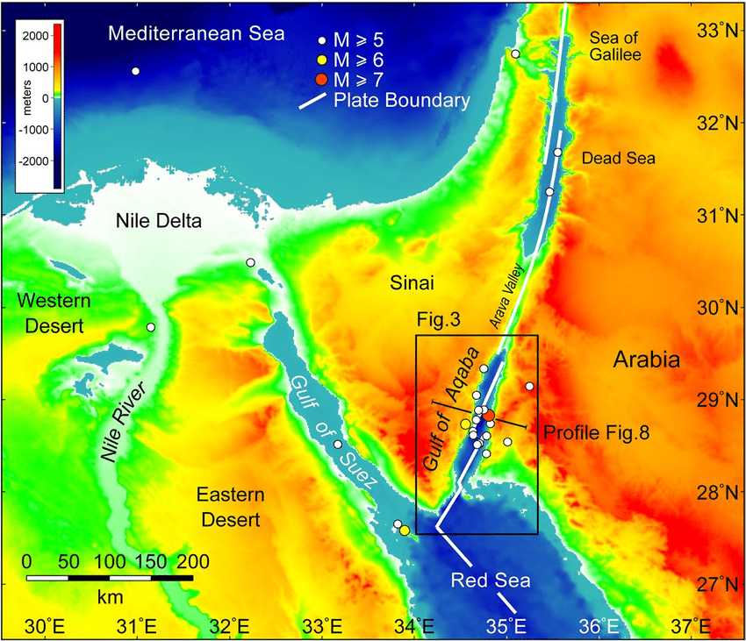
Geology of Land Bridge II
Note the intense seismicity in the area of the land bridge. Because the land bridge is sitting on a transform fault, sheer forces and uplifting would be very active for at least 125,000 years¹. The underwater land bridge would have been over the most active area of seismicity and uplifting in the entire 800 mile rift zone.
“Uplift has been greatest adjacent to the central sub-basin and the seismicity decreases to the north and south….Consequently the potential for future destructive earthquakes in the central Gulf is great and are in this area’s future” ¹.
Notes:
1. Evaluation of the Crustal Features of the Gulf of Aqaba Source also includes graphic of seismicity.

Slide 8
Wati Wadir is where the Israelites entered the Nuwieba Peninsula
Braided streams form where channels are choked by sediment. Flow is forced around sediment obstructions
Shallow waters showing coral reefs emphasizing the calmness of the gulf and sediment free waters. (Today the gulf is calm and a wonderful tourist spot). There are steep mountains and uplifted features all the way to the shore. The shore is irregular but smooth. Note the alluvial river across the beachhead clogged with sediment. This is an emergent shoreline, if there ever was one!
Pharaoh’s army camped here

Slide 9
Clasts to the rescue
Eastern Sinai is studded with hundreds of miles of wadis or dry river beds. Dry, unvegetated land, dissected by dendritic stream gullies with sharp peaks are called badlands. When heavy rains come, wadis are full of enormous runoff including megatons of clasts and gravel broken from the rock surfaces of the hundreds of square miles of mountains that they drain.
Mountains at the shores continue underwater as steep canyons. It so happened that the main contributor and watershed trunk receptacle for clasts washing down from the mountains in the entire area was Wadi Watir.. Wadi Watir is a large river valley basin (graben) and was also the only passable route to the Exodus staging area for the crossing. Wati Watir now has a scenic highway traversing it.
Huge amounts of clasts over the millennia have been washed out from the hundreds of square miles of eroding mountains cut by ravines and forming wadis (river beds). Over the thousands of years they paved an underwater bridge likely raised as a block dip/slip fault, By this time the clasts paved the underwater bridge across the gulf to Arabia they were rounded and well sorted. Aqaba waters are calm, so not a lot of sediment settled on the clasts. Typically, on the floor of ocean basins sediment is meters thick. God uses geology in His works!
Moses was not acquainted with the route God told him to follow so Israel was led by a pillar of dust during the day and a pillar of fire at night. Israel pitched only one camp, Etham, for the journey of about 10 days. Other than that one camp, Josephus⁷ says Israel walked day and night, hence the need for the pillar of fire. Moreover, the Jews numbered 2 million. With these two pillars, everyone could see the direct route and none were lost.
The Nuweiba Peninsula was plenty big as a staging area for two million. (Men + women and children)
As mentioned, very steep drops offs on either side. Artifacts from the Egyptian army found on the part of the land bridges remaining, but most fell in to the deepest of the deep on either side of bridge, too deep to explore…. Or recover.
Notes:
Recognition of clasts for safe walking on the land bridge and their source by Exodus Case by Lennart Möller, M.D, an online book

Slide 10
Israel Crosses the Gulf of Aqaba About 3,950 years ago
Egypt is now a country in profound crisis. The country has been badly damaged by a number of disasters. The whole population has suffered from blistering skin sores. Hail rained down and then set fire to everything else Then came three days of darkness That unarmed slaves walked away from the world’s superpower with loads of gold lead by a traitorous ex-prince of Egypt was unacceptable even after experiencing the ultimate punishment, death of the nation’s first born, including those of all animals. This included Pharaoh’s son, Tutankhamen. The plagues did not affect the slaves in Goshen.
2 million Israelites have made 10 day journey, walked down Wadi Watir and are camped on the beach,, about 8-12 miles across the gulf from Arabia. Treacherous, 2,500m tall, impassible mountains very steep all the way to the ground were behind Israel. The Gulf of Aqaba was in front of Israel. Meanwhile pharaoh’s armies had caught up to the Israelites. Convinced of no escape and mocking Moses’ stupidity, they camped in Wadi Watir to rest for the slaughter.
“And the angel of God, which went before the camp of Israel taking the pillar of the cloud behind Israel and (placing it) before the Egyptians which became a cloud of darkness” (Ex.14:19-20). Egyptians are wrapped in total darkness, and the Israelites received maximum light from the pillar of fire. At that point Moses raises his shepherd’s rod.
The sea was cut open as if with a knife*. A tsunami could not explain, 12 miles of water standing on edge at least 24 hours. There is no wind that can blow a 12 miles long, several hundred meters deep ditch through a sea and leave dry, walkway. Such a strong wind would wipe out every living thing and blow the Egyptian Army back to Egypt. After the sea was opened, a wind blew a number of hours to dry the clasts on the land bridge. When dry, a column of fire lighted their way and detained Pharaoh. The journey for 2 million Israelis took about 24 hours, the bridge was thought to be 2 km wide. The Egyptians cannot see any of this; they are in the dark. Egypt still does not realize she is fighting God
Israelites walked across onto the dry sea bed that had very little oceanic sediments (usually meters thick on seafloors).
After journey across the gulf, Israel, camped on the Arabian shore. God removed the darkness from Pharaoh’s army which then gave pursuit, chariots first according to Josephus*. After the entire army was in the middle of the gulf, Moses closed the waters and Egypt was drowned. The waters washed up the spears, swords, knifes, slings, shields, bows and arrows, which the Israelites collected and afterward were no longer defenseless.
Notes:
*Description of the opening of the sea and crossing by Flavius Josephus in Antiquities of the Jews. Online pdf book given on the final slide.

Slide 11
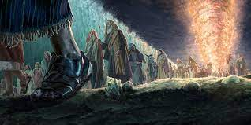
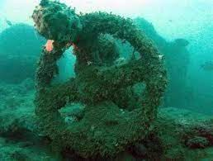
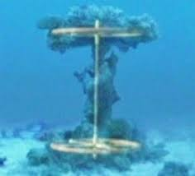
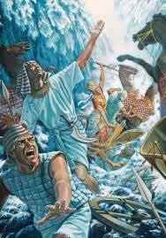
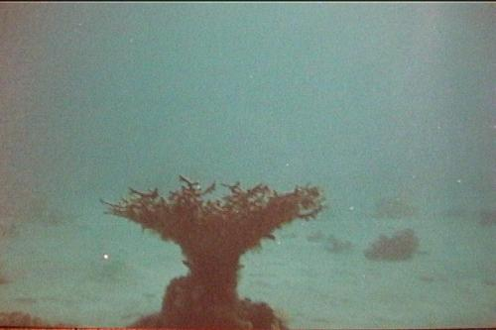
Safely across
Here are some pics of the artifacts found on the underwater land bridge, which has not completely subsided yet, thought to be 2 km wide at the time of the crossing. They are of the correct dynasty which was the 18th dynasty. Remember, the bridge has extremely deep drop-offs on either side Undoubtedly, more artifacts could be found in these deep marine canyons but it would take Alvin (deep water submersible), and permission of the Saudis. Horse and human remains and chariots with the cab attached have been found . Many more are displayed in the Exodus Case book

Slide 12
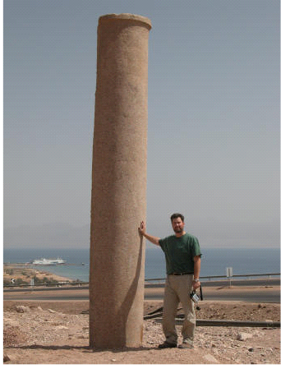
Solomon installed two granite columns to commemorate the site of the crossing
Ron Wyatt found the crossing in 1978. Significant to Ron were the two granite obelisks King Solomon installed around 950 BC to mark the site of the crossing 400 years afterwards. One was found on the Nuweiba beach and a sister column found across the Gulf in Arabia.
The red granite Nuwieba column had gone unnoticed for centuries and was hidden in plain sight, lying on its side. Solomon's sea port was at the northern tip of the Gulf of Aqaba at Eilat (I Kings 9:26).The Bible even mentions this column! Isaiah 19:19, "In that day there will be an altar to the Lord in the midst of the land of Egypt, and a pillar to the Lord at its border.“ Ron found a sister column in Saudi Arabia matching the one on the Sinai side. The Hebrew words, Mizram (Egypt), death, water, pharaoh, Edom, Yahweh, and Solomon were on that column. We get our word “misery” from the Hebrew word for Egypt. Slavery is as miserable as it gets.

Slide 13
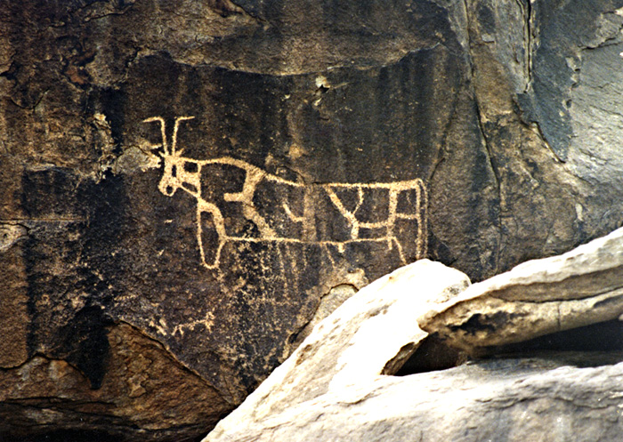
The Travelogue to the Ten Commandments
The Israelites depart the shore where they landed and enter the Wilderness of Shur on their way to Mt.Horeb, (Jabal Al Lawz), the real mount Sinai, a small mountain, about 2,600 feet tall, but the tallest in the area, on a journey that took about 6 weeks or about 40 days. Israel faced many tests along the way’. It would take a miracle for 2 million to survive in these badlands. And that’s exactly what they got.
After 3 days the water they carried was exhausted. They were desperate and thirsty. The Scouts had found water but it was not drinkable. Moses threw a branch into the waters which immediately purified them for 2 million plus livestock. For food, bread rained and was gathered in the morning except on the Sabbath day of rest. Quail were sent into the camp in the evening for meat. Bread and meat continued to follow the them for 40 yeas. Manna was a wondrous food because it was nutritionally complete, delicious, and likely obliterated yearnings or traditional foods. Animals probably ate manna also because the desert certainly did not have enough or the right forage for animals. Josephus says manna tasted like honey cakes⁷. No way could a large nation survive 40 years in a environment even the Bible calls a ‘wilderness’ without miraculous water, food and forage.
Here is one Israeli campsites showing that the golden calf idol was on many minds. These types of glyphs were present at many camp sites. Despite many wonders and miracles, Israelites found freedom uncomfortable at first and remained attached to Egypt. Highly displeasing to God after “He took them by the hand and led them from slavery”.
Notes:
7. Description of Manna and hardships. Flavius Josephus in Antiquities of the Jews. Online pdf book given on the final slide.

Slide 14
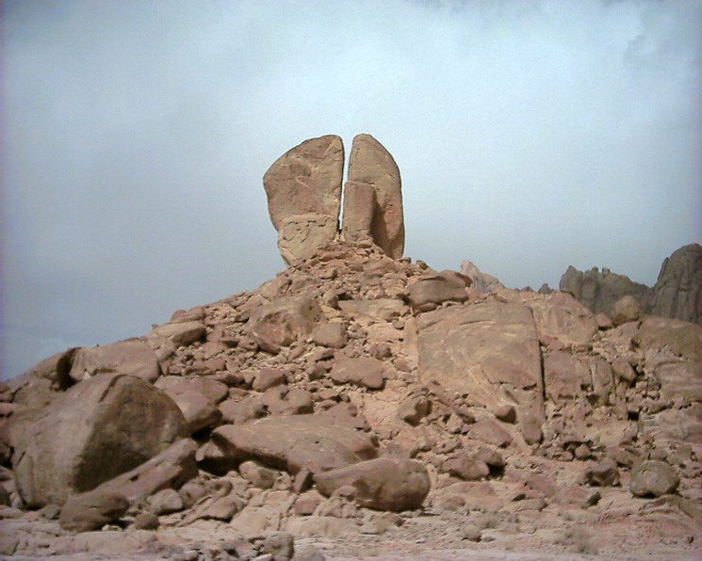
After arriving at Mount Sinai, again, there was no water. Moses struck this rock called the Rock of Horeb to provide water.
It is a six stories tall granite rock situated on hill above a plain on the western side of Mount Horeb/Sinai. It is unlike any other rock in the area. The rock is weathered. There are no differential signs of compression, extension, foliation or bedding on the rock. But there are definite sign of water flow and lots of it. This rock can be seen from Google Earth.
Poorly sorted but rounded clasts seen below the Rock of Horeb, show clear evidence of a river bed, not a periodic stream.
Degree of sorting increases with transport distance..So the poor sorting points to the rock as standing close to the water source. Josephus says it was a river*
See this recent drone footage
Notes:
*Description of the Rock of Horeb Flavius Josephus in Antiquities of the Jews. Online pdf book given on the final slide.

Slide 15
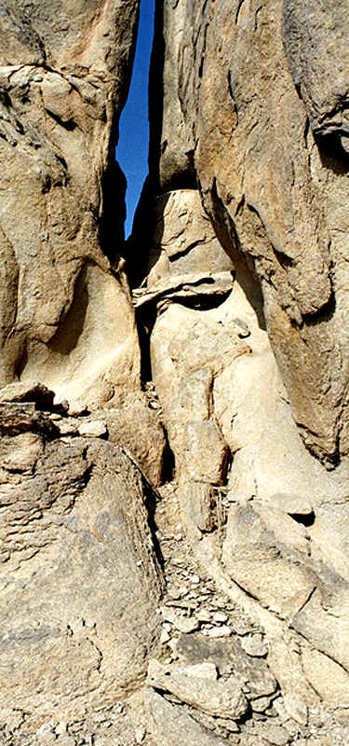
Rock of Horeb close up
Solitary Rock of Horeb showing weathering and surrounded by rock fragments. It is a fine grained granite so it likely cooled quickly as an pluton, dike, or sill extrusion. Water which came out did not have enough energy to sort the clasts better.

Slide 16
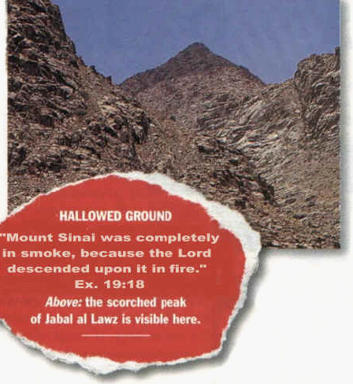
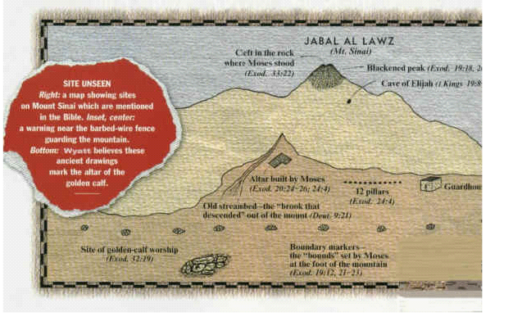
Mount Sinai, Horeb or Jabal Al Lawz
Forbidden Entire site is strung with 8 foot high fence topped by sturdy barbed wire. This is the guardhouse
The top 1/3 of Mt. Sinai (Horeb) is covered with obsidian, an volcanic, extrusive, glassy, igneous rock. It has silicon-oxygen covalent bonds but they are not organized into a repeating structure to hold it together for strength. So it does not weather well, geologically speaking, like the parent granite. It is formed when silicon rich felsic magma (from the granite) is suddenly cooled. Since this is a transform boundary there are no lava flows or volcanic mountain building. Obsidian is not found elsewhere except here. The surrounding topography is highly eroded, but not the obsidian clasts which are definitely much more recent! Bible says the coming of the Lord “in fire like a furnace blackened the mountain”. The obsidian is the fingerprint left by the Lord.
Note the slight cleft at the top of Mt Sinai where Moses stood to announce receipt of the Ten Commandments The acoustics are excellent and 2 million Israelites could have heard him. A little ways down is the cave described in the Bible, where Elijah is thought to have hidden from Jezebel 1,400 years later.
Notes:
Investigators noted presence of obsidian years ago but unlikely recognized its significance as not natural to this area since there is no volcanism and definitely younger than the urrounding granite.
Pictures credit from The Exodus Discovery.
The Exodus Case book has the same pictures but the book is pdf format and the pictures do not copy well, so I found alternate sources.
This is also the site where Moses aided by His brother-in-law and Aaron held up his rod so Israel could defeat the Amalekites, a war-like people who had been attacking and killing women and children at the rear of the march.

Slide 17
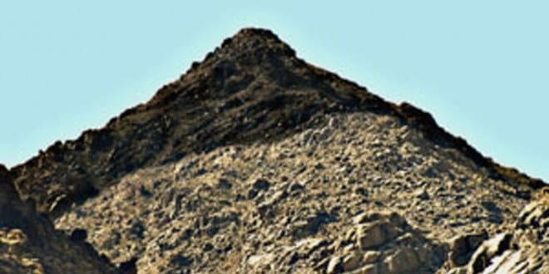
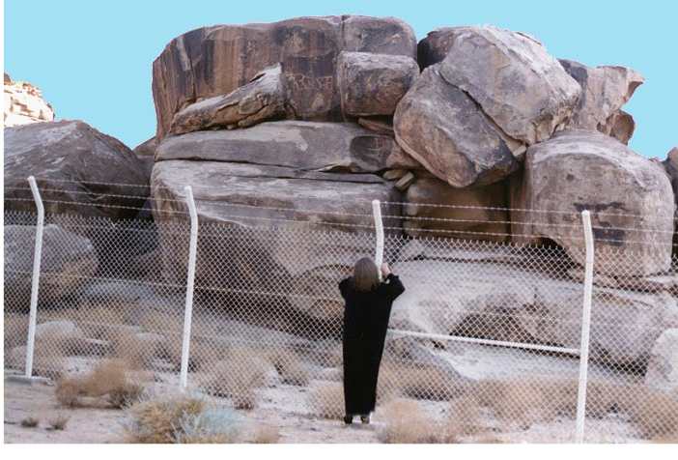
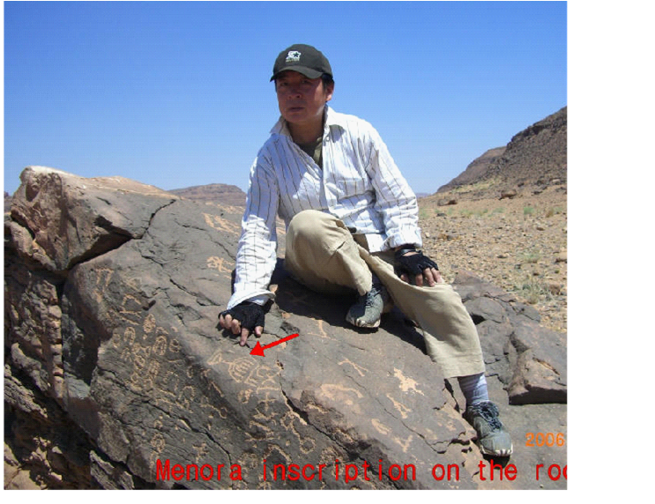
Mt. Sinai with black crown
Blackened crown of Mt Sinai
Fence surrounds Mt Sinai complex. Woman gazes upon the altar to the Golden Calf. Hebrew glyphs can be seen carved into rocks.
Oldest known picture of the Menorah carved into rock at camp site. Israel stayed in the area about a year.

Slide 18
So How Did Moses Cross the Gulf of Aqaba?
Fault-block mountain building that raised a slip-dip land bridge adding seismicity for the final touches in just the right spot.
Well sorted, smoothed, rounded clasts from a mighty river basin receptacle draining hundreds of square miles water shed which paved the bridge.
A gentle wind which dried the paved bridge.
A tower of fire to light the way.
And a lot of help from God who left fingerprints in fried, igneous rocks on Mt Sinai after He wrote the Ten Commandments.
Notes:
1. Exodus Case: http://library.mibckerala.org/lms_frame/eBook/The%20Exodus%20Case%20-%20Dr.%20Lennart%20Moller.pdf
2. Evaluation of the Crustal Features of the Gulf of Aqaba:
https://www.scirp.org/journal/paperinformation.aspx?paperid=91821.
3. Seismic Hazard Implication: https://www.researchgate.net/publication/313971376_Seismic_Hazards_Implications_of_Uplifted_Pleistocene_Coral_Terraces_in_the_Gulf_of_Aqaba%20footwall%20uplift
4. Red Sea Rift: https://www.geologypage.com/2013/01/red-sea-rift.html
5. Extentional parting of the Red Sea: http://structuralgeologyof.weebly.com/extensional/the-parting-of-the-red-sea”
6. The Exodus Discovery: http://exodusdiscovery.com/
7. Josephus: Antiquities of the Jews Translation 1667 by Wm. Whiston: https://www.gutenberg.org/files/2848/2848-h/2848-h.htm
8. Geological and Engineering Properties of Granite Rocks from Aqaba Area, South Jordan: https://file.scirp.org/Html/2-1110121_62775.htm

